Slide 1
HTML – The Basics

Slide 2
Tags
HTML code uses ‘tags’
Tags tell the program how to present the information
Tags are written within brackets <example>
There are almost always two tags – an opening and a closing tag
Every HTML file starts with <html> and ends with </html>

Slide 3
Important Tags in a Document
<head>
<title>
<body>
<html> <head> <title> My page </title> </head> <body> This is the content </body> </html>

Slide 4
Block Tags
Heading tags <h1> <h2> <h3> are used for headings
Paragraph tags <p> make paragraphs
Break tags <br> show text on a new line
<body> <h1> My first heading </h1> <p> This is the content </p> <h2> My second heading </h2> <p> More content <br> will appear here </p> </body>
My first heading This is the content My second heading More content will appear here

Slide 5
Inline Tags
Inline tags let you format text within sentences
Bold <b>, Italics <i>, Underline <u>
<body> <p> This makes text <b> bold </b> <br> This makes text <i> italics </i> <br> This makes text <u> underlined </u> </p> </body>
This makes text bold This makes text italics This makes text underlined

Slide 6
Attributes
Attributes change how tags display text
They use the ‘style’ command
<body style=“color:blue;”> <h1 style=“text-align:center;”> My page </h1> <p style=“font-size:36px;”> Nice big text </p> <br> <p> Or I can make it <i style=“font-size:36px;”> big like this </i> </p> </body>
My page Nice big text Or I can make it big like this

Slide 7

Graphics
The <img> tag is used to put graphics on the page
It doesn’t need a closing tag
E.g. <img src=“filename.jpg”>
<body> <p> Here is my picture </p> <img src=“stones.jpg”> <p> Isn’t it beautiful? </p> </body>
Here is my picture Isn’t it beautiful?

Slide 8
Hyperlinks
Hyperlinks use anchor tags <a></a> to open a new webpage or document
E.g. <a href=“filename.html”> text to be clicked </a>
You can make a text hyperlink or an image hyperlink
<body> <p> Click <a href=“new_page.html”> here</a> to open a new page </p> <p> Or you can click on the picture </p> <a href=“new_page.html”> <img src=“stones.jpg”> </a> <p> to open a new page </p> </body>
Click here to open a new page Or you can click on the picture to open a new page

Slide 9
Menu Bar
You can make a menu bar or a list with the “unordered list” <ul> and the “list item” <li> commands
Remember menu bar items will need to be hyperlinks
<body> <ul> <li><a href=“home.html”> Home </a> </li> <li><a href=“intro.html”> Intro </a> </li> <li><a href=“contact.html”> Contact us </a> </li> </ul> </body>
Home Introduction Contact us

Slide 10
Tables
Tables are ways to structure your webpage
The command is <div>
<body> <div> <ul> <li><a href=“home.html”> Home </a> </li> <li><a href=“intro.html”> Intro </a> </li> <li><a href=“contact.html”> Contact </a> </li> </ul> </div> </body>

Slide 11
Example 1 – Menu bar (HTML)
<div> <ul> <li><a href=“index.html”> Home </a> </li> <li><a href=“blog.html”> Blog </a> </li> <li><a href=“forum.html”> Forum </a> </li> <li><a href=“videos.html”> Videos </a> </li> <li><a href=“philosophy.html”> Philosophy </a> </li> </ul> </div>

Slide 12
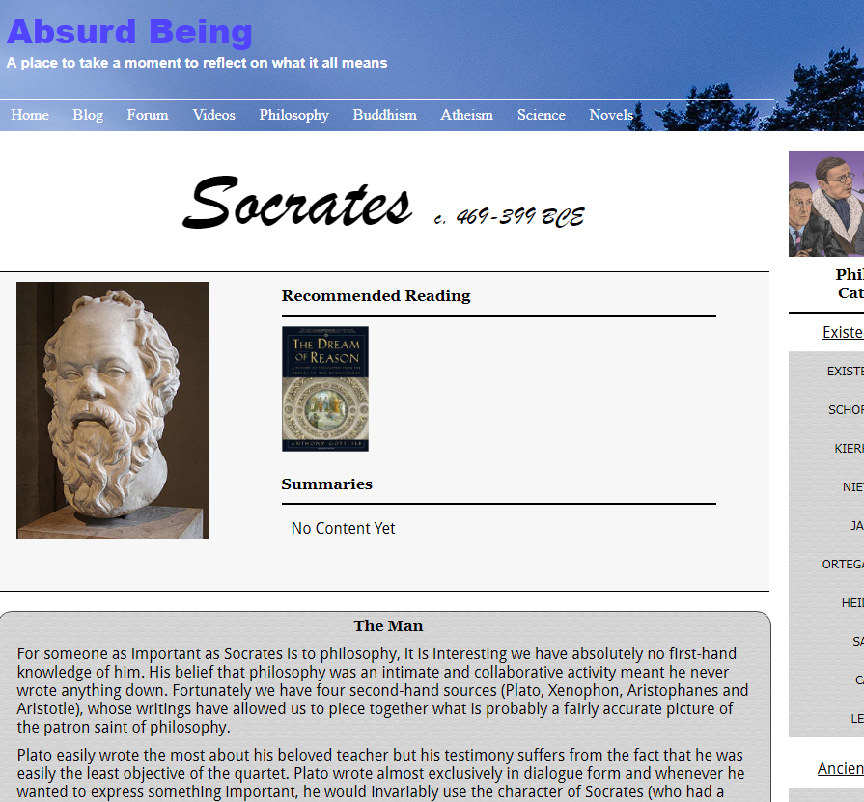
Example 1 – Menu bar (Webpage)

Slide 13
Example 2 – Table with image (HTML)
<div> <img src="images/socrates.jpg"> <h3>Recommended Reading </h3> <a href=“http://www.amazon.com/The-Dream-Reason/dp/084747674”> <img src =“images/dream_of_reason.png”> </a> </div>

Slide 14
Example 2 – Table with image (Webpage)

Slide 15
Example 3 – Table with text (HTML)
<div> <h3>The Man</h3> <p>For someone as important as Socrates is to philosophy, it is interesting to… </p> </div>

Slide 16
Example 3 – Table with text (Web page)

